Slide 1
ATAI
Advanced Techniqueof Artificial Intelligence
ATAI
ChongqingUniversity _{AdvancedTechniqueof}
of Technology Artificial Intelligence
Chongqing University of
Technology
Chongqing University ^{ATAI}
_{of Technology} Advanced Techniqueof
Artificial Intelligence
Chongqing University of Technology
Chongqing University of Technology
AlignMamba: Enhancing Multimodal Mamba with Local and Global
Cross-modal Alignment
Code:none
2025.3.25 •ChongQing
—— CVPR 2025
Reported by YaoChen Li
1

Slide 2
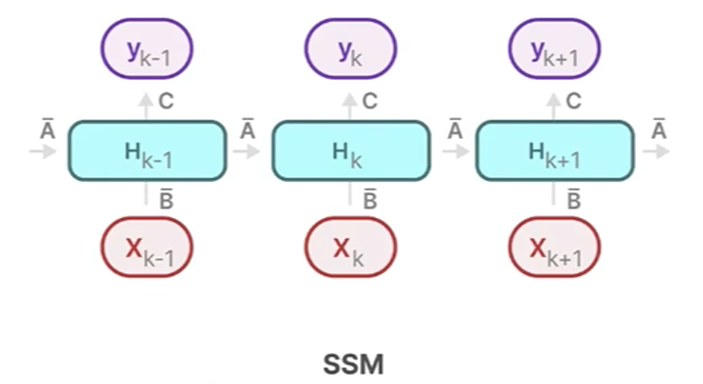
ATAI
AdvancedTechniqueof
Artificial Intelligence
ATAI
ChongqingUniversity _{AdvancedTechniqueof}
of Technology Artificial Intelligence
ChongqingUniversity of Technology
Mamba

Slide 3
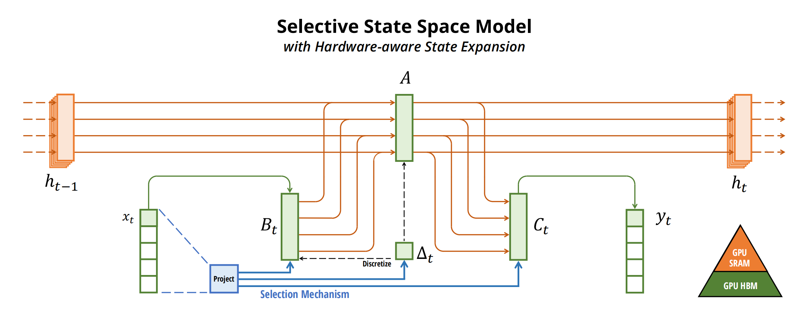
ATAI
AdvancedTechniqueof
Artificial Intelligence
ATAI
ChongqingUniversity _{AdvancedTechniqueof}
of Technology Artificial Intelligence
ChongqingUniversity of Technology
Mamba

Slide 4
ATAI
AdvancedTechniqueof
Artificial Intelligence
ATAI
ChongqingUniversity _{AdvancedTechniqueof}
of Technology Artificial Intelligence
ChongqingUniversity of Technology
Motivation
(1)The computational complexity of attention mechanisms makes them inefficient for processing long-sequence or large-scale data common in real-world multimodal applications.
(2)Mamba’s sequential scanning mechanism, while computationally efficient, struggles to capture comprehensive cross-modal relationships, particularly with unscanned tokens. This inherent limitation consequently affects the quality of learned multimodal fusion representations.

Slide 5
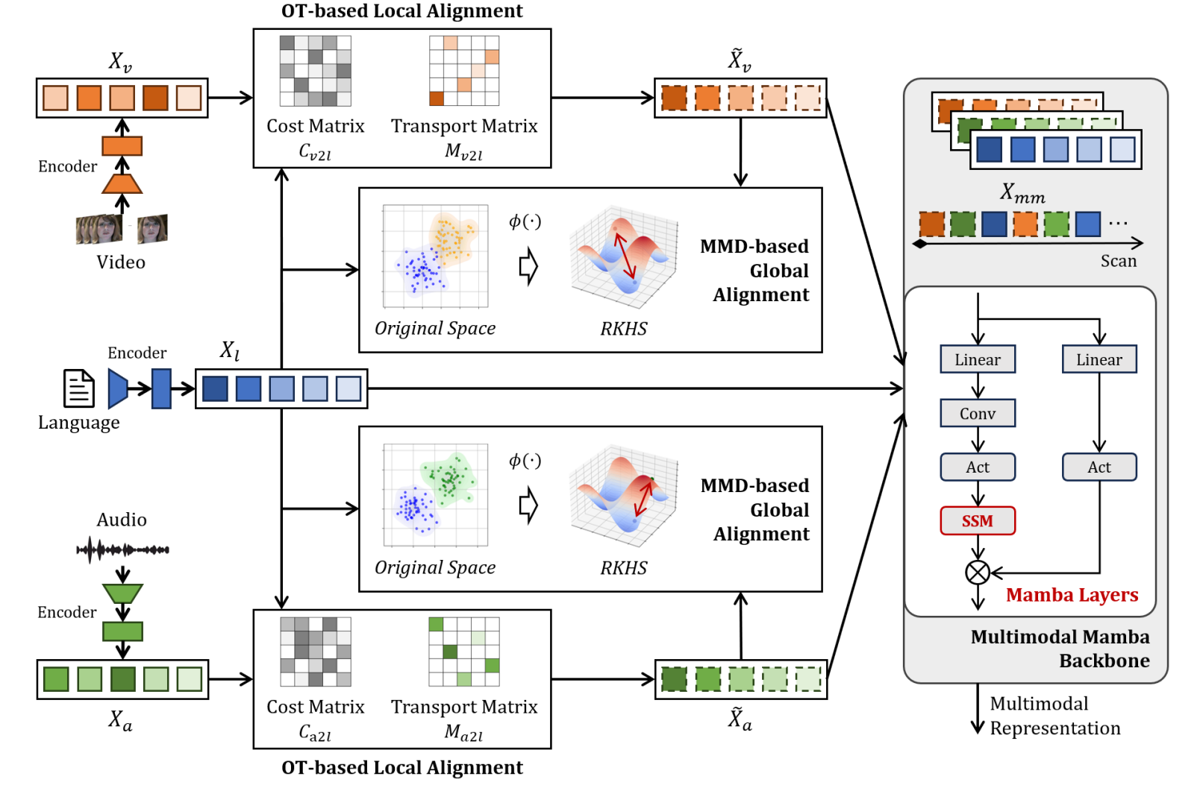
ChongqingUniversity of Technology
ATAI
AdvancedTechniqueof
Artificial Intelligence
ATAI
ChongqingUniversity _{AdvancedTechniqueof}
of Technology Artificial Intelligence
Overview

Slide 6
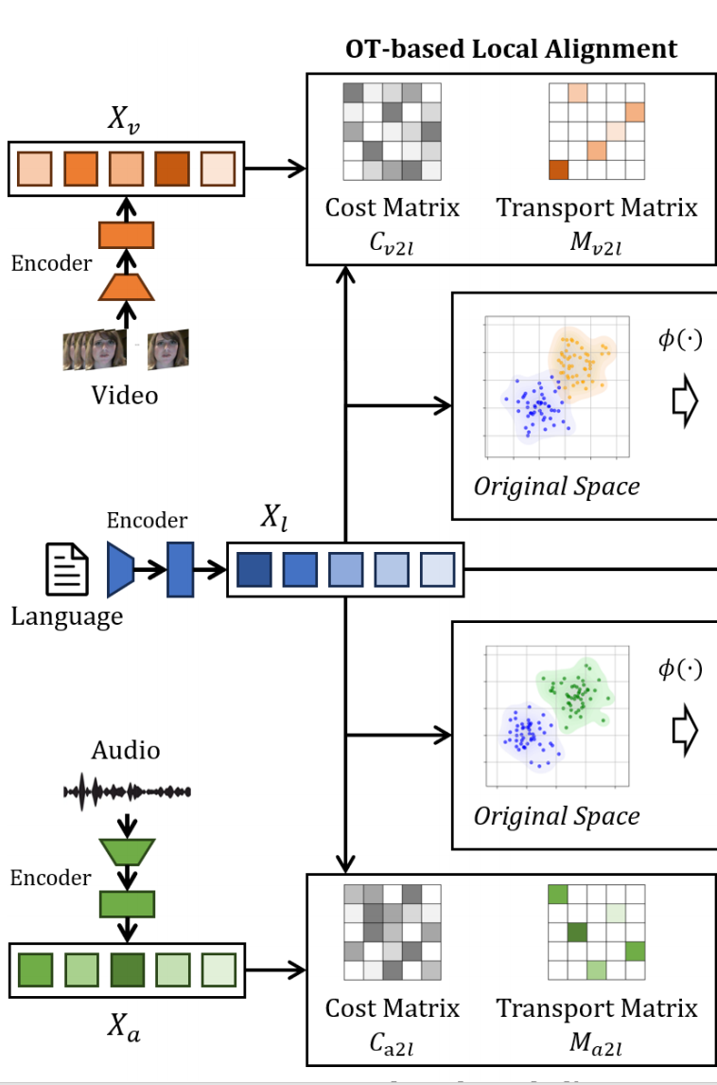
ChongqingUniversity of Technology
ATAI
AdvancedTechniqueof
Artificial Intelligence
ATAI
ChongqingUniversity _{AdvancedTechniqueof}
of Technology Artificial Intelligence
Method

Slide 7
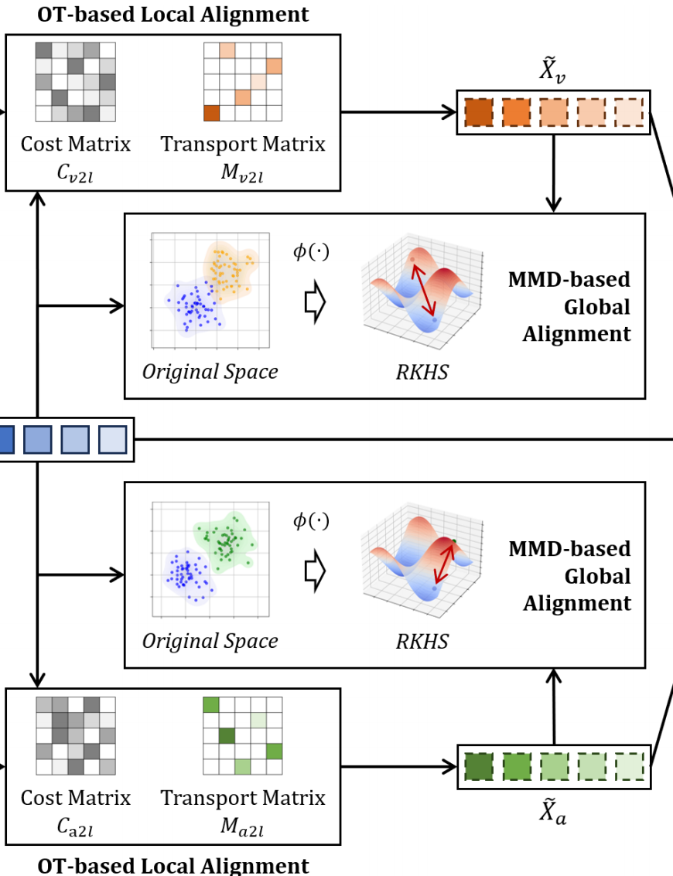
ChongqingUniversity of Technology
ATAI
AdvancedTechniqueof
Artificial Intelligence
ATAI
ChongqingUniversity _{AdvancedTechniqueof}
of Technology Artificial Intelligence
Method

Slide 8
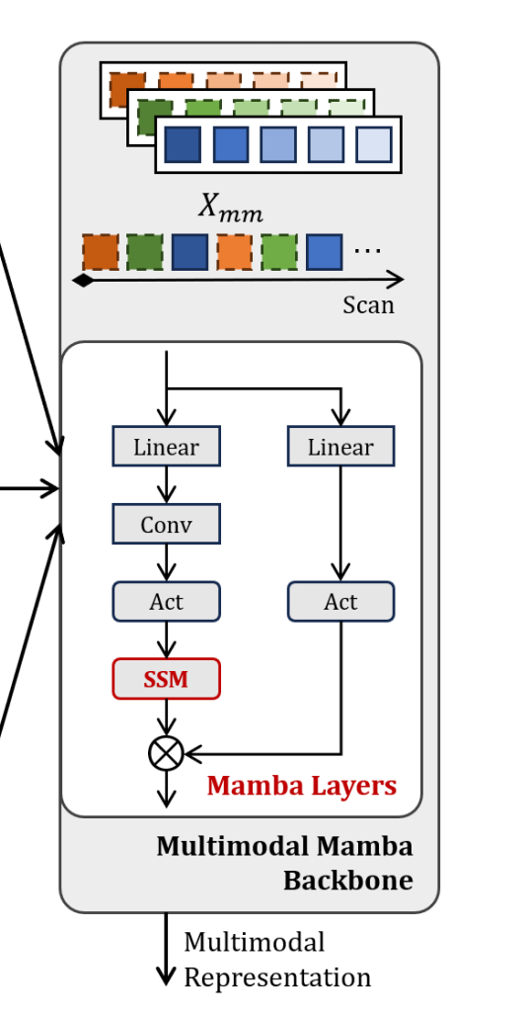
ChongqingUniversity of Technology
ATAI
AdvancedTechniqueof
Artificial Intelligence
ATAI
ChongqingUniversity _{AdvancedTechniqueof}
of Technology Artificial Intelligence
Method

Slide 9
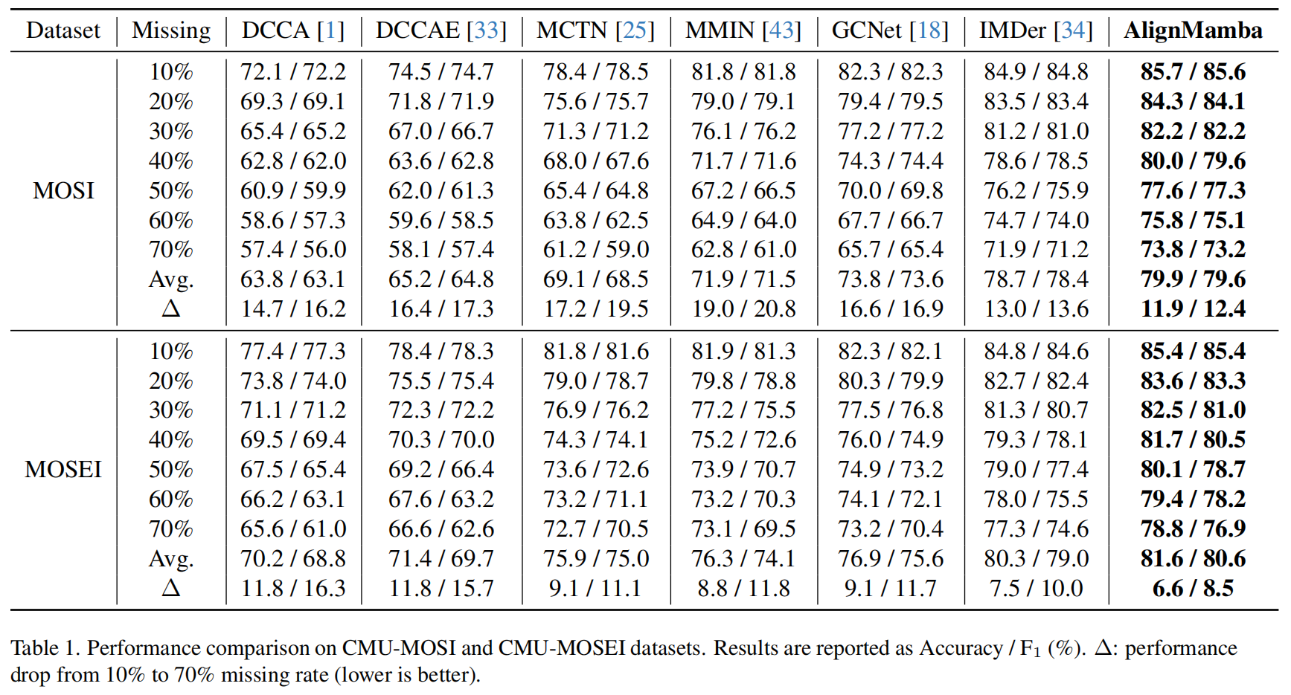
ATAI
AdvancedTechniqueof
Artificial Intelligence
ATAI
ChongqingUniversity _{AdvancedTechniqueof}
of Technology Artificial Intelligence
ChongqingUniversity of Technology
Experiments

Slide 10
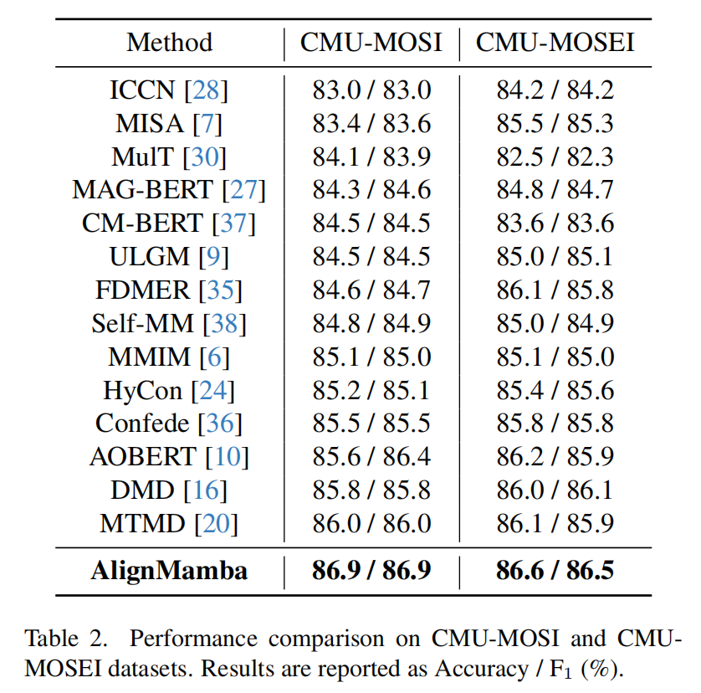
ATAI
AdvancedTechniqueof
Artificial Intelligence
ATAI
ChongqingUniversity _{AdvancedTechniqueof}
of Technology Artificial Intelligence
ChongqingUniversity of Technology
Experiments

Slide 11
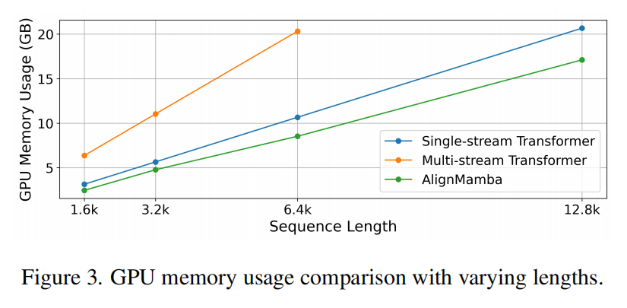
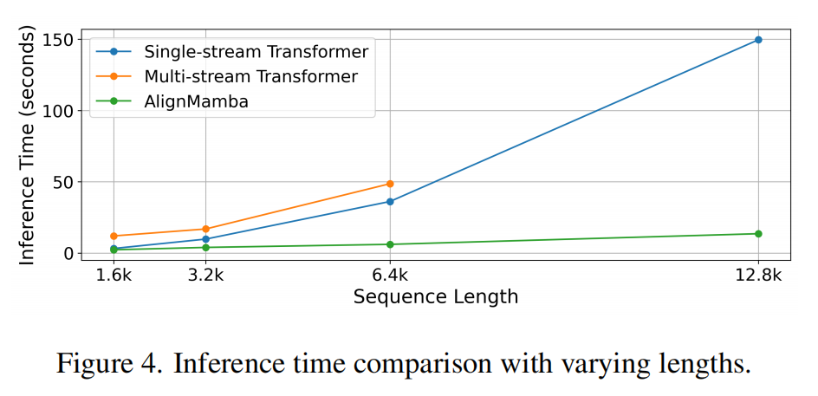
ChongqingUniversity of Technology
ATAI
AdvancedTechniqueof
Artificial Intelligence
ATAI
ChongqingUniversity _{AdvancedTechniqueof}
of Technology Artificial Intelligence
Experiments

Slide 12
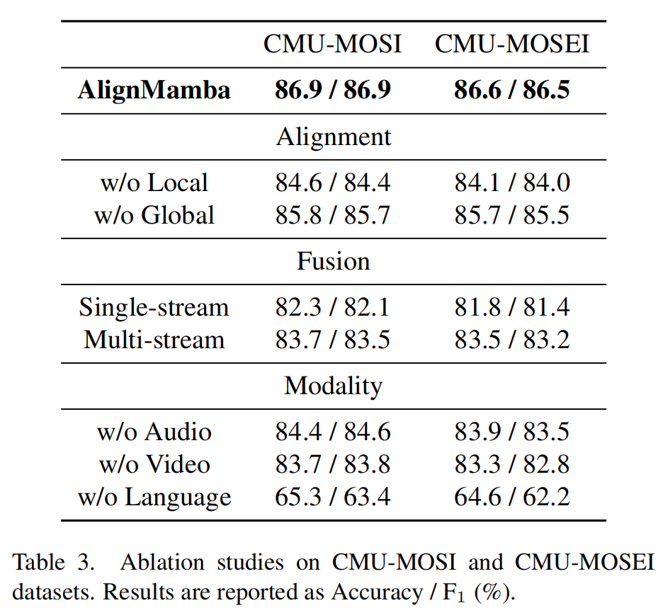
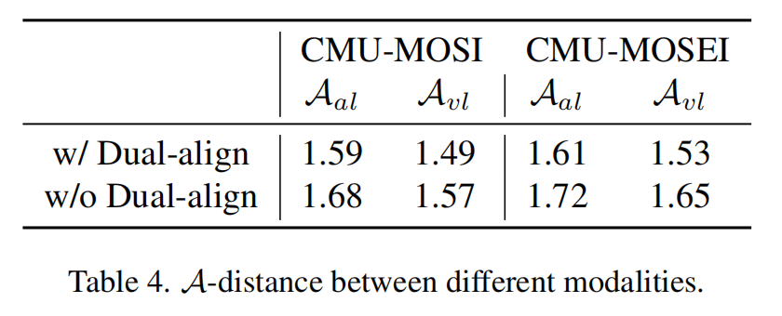
ChongqingUniversity of Technology
ATAI
AdvancedTechniqueof
Artificial Intelligence
ATAI
ChongqingUniversity _{AdvancedTechniqueof}
of Technology Artificial Intelligence
Experiments

Slide 13
ChongqingUniversity of Technology
ATAI
AdvancedTechniqueof
Artificial Intelligence
ATAI
ChongqingUniversity _{AdvancedTechniqueof}
of Technology Artificial Intelligence
Experiments

Slide 14
ChongqingUniversity of Technology
ATAI
AdvancedTechniqueof
Artificial Intelligence
ATAI
ChongqingUniversity _{AdvancedTechniqueof}
of Technology Artificial Intelligence
Thanks!

